Slide 1
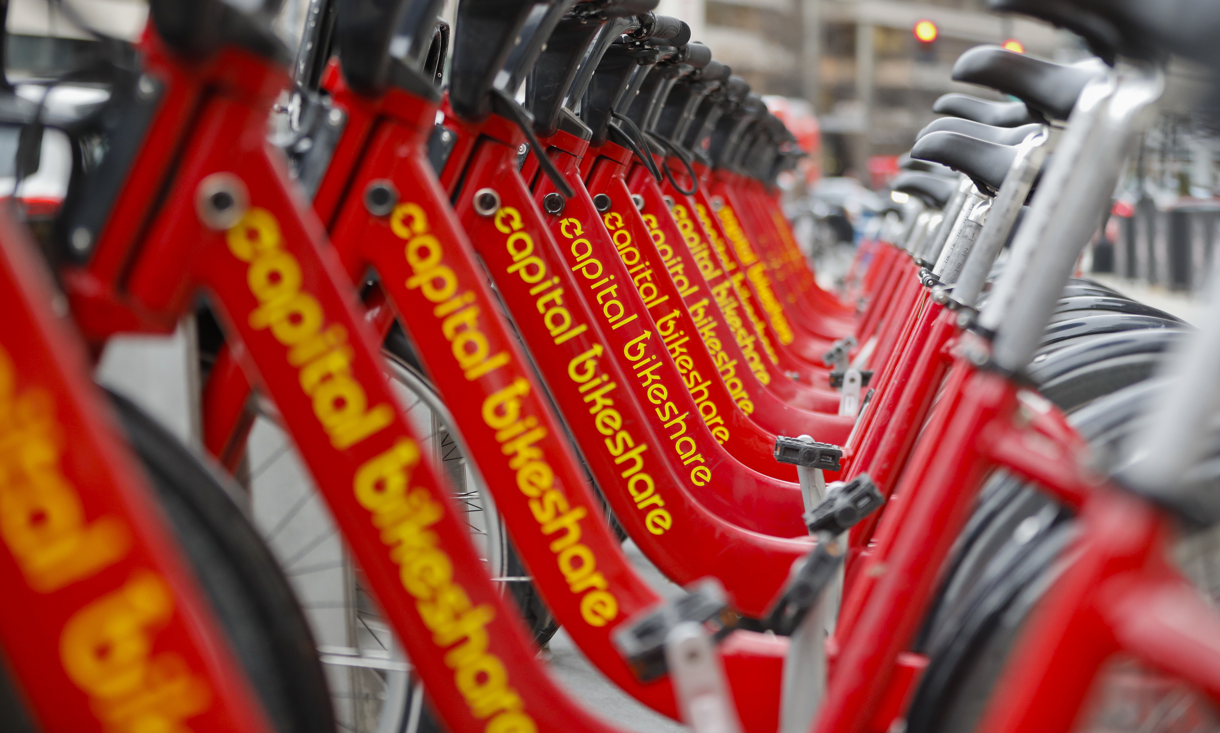
Capital Bikeshare: Post Pandemic Analysis
Presented by: Joel Wiseman, Max Glasser, George Kalad, Hina Ahmed

Slide 2
Introduction
This project is designed to analyze usage of Capital Bikeshare during the initial recovery period of COVID-19, with focus on the following:
Overall ridership
Primary usage
Members vs. Non-Members
Impact of weather
Geographic area

Slide 3
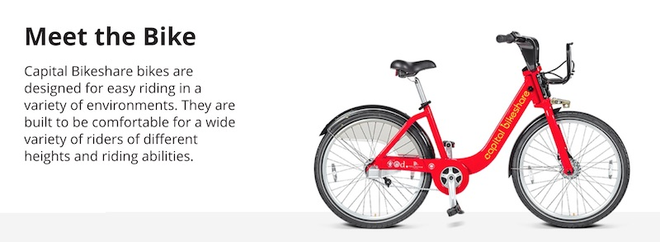
Brief History
Bikeshare is not a new concept, they have been around since the 1960s
Technology has made bikeshares more accessible than ever before

Slide 4
About Our Data
Data was collected from: https://capitalbikeshare.com/system-data
The data included information on:
Rider ID
Start and End Date and Time
Type of Bike (Electric or Classic)
Start and End Station Name, ID, and Latitude/Longitude
Member Type (Member or Casual)
Added Columns Included
Day of Week
Ride Duration
Month

Slide 5
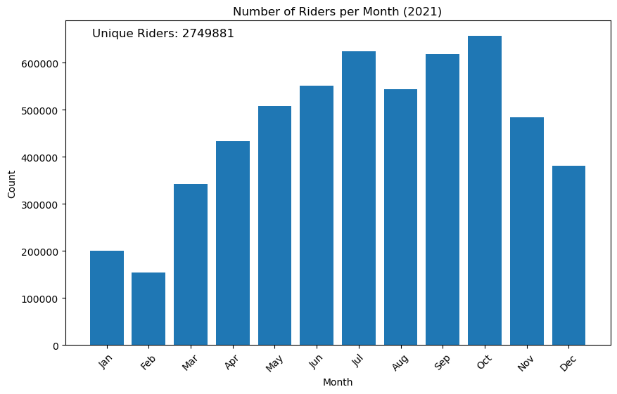
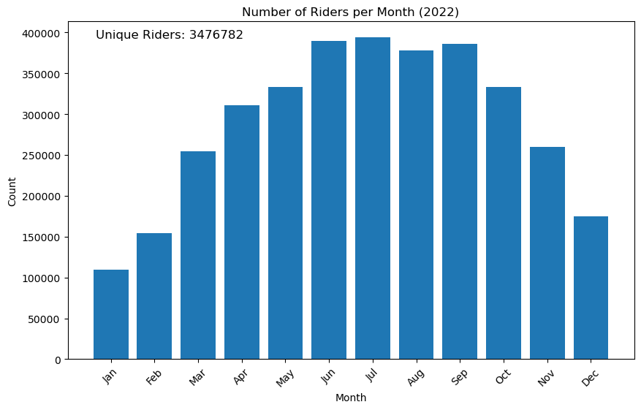
Overall Ridership by Month

Slide 6
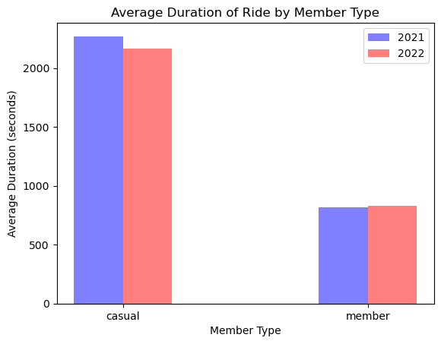
What Does Membership Mean?

Slide 7
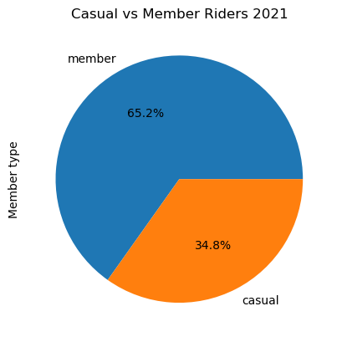

Membership or Not?

Slide 8
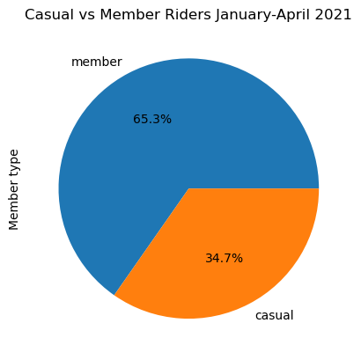
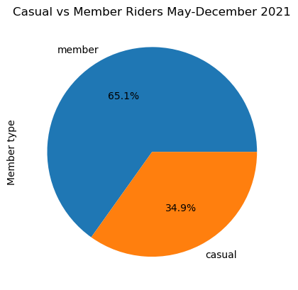
Further Analysis: Vaccine Availability

Slide 9
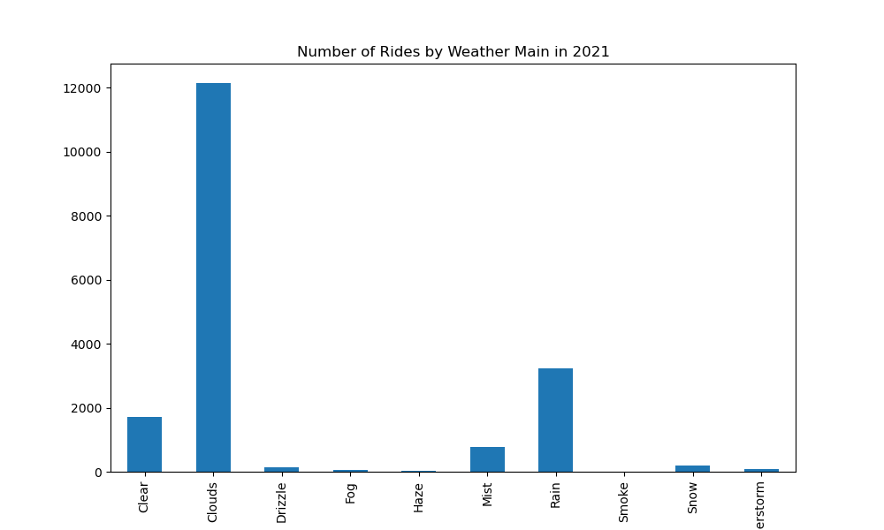
Rain or Shine?

Slide 10
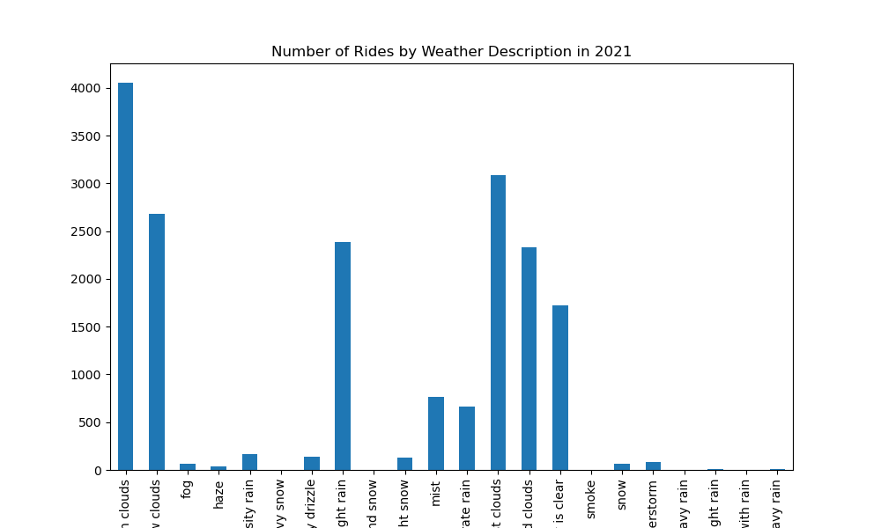
Rain or Shine?

Slide 11
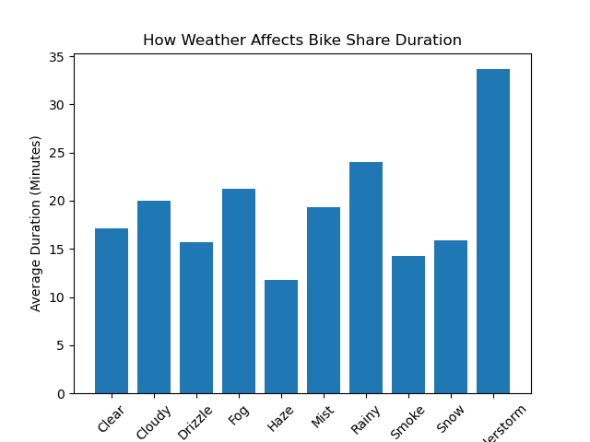
Rain or Shine?

Slide 12
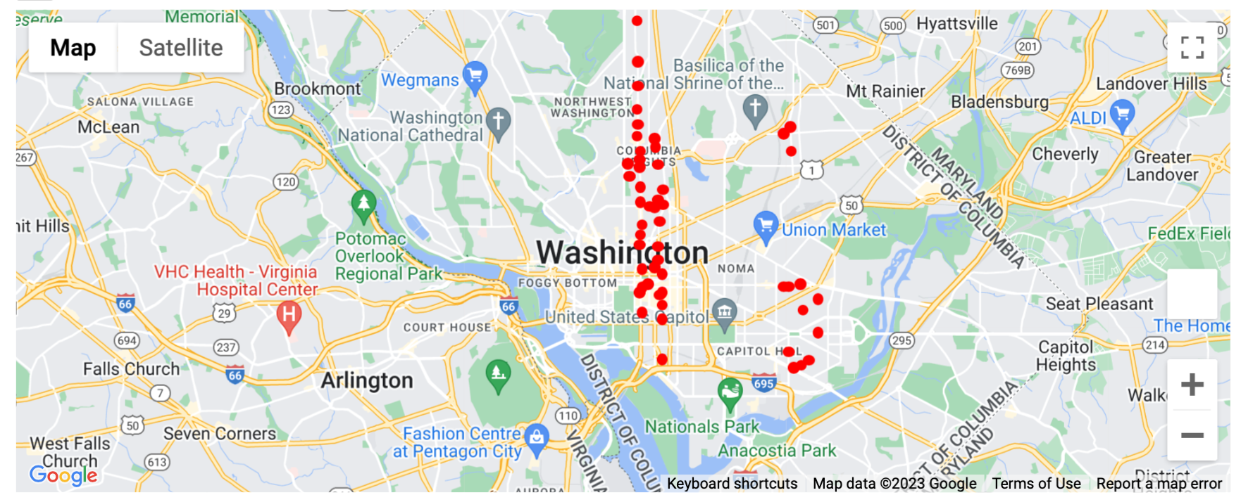
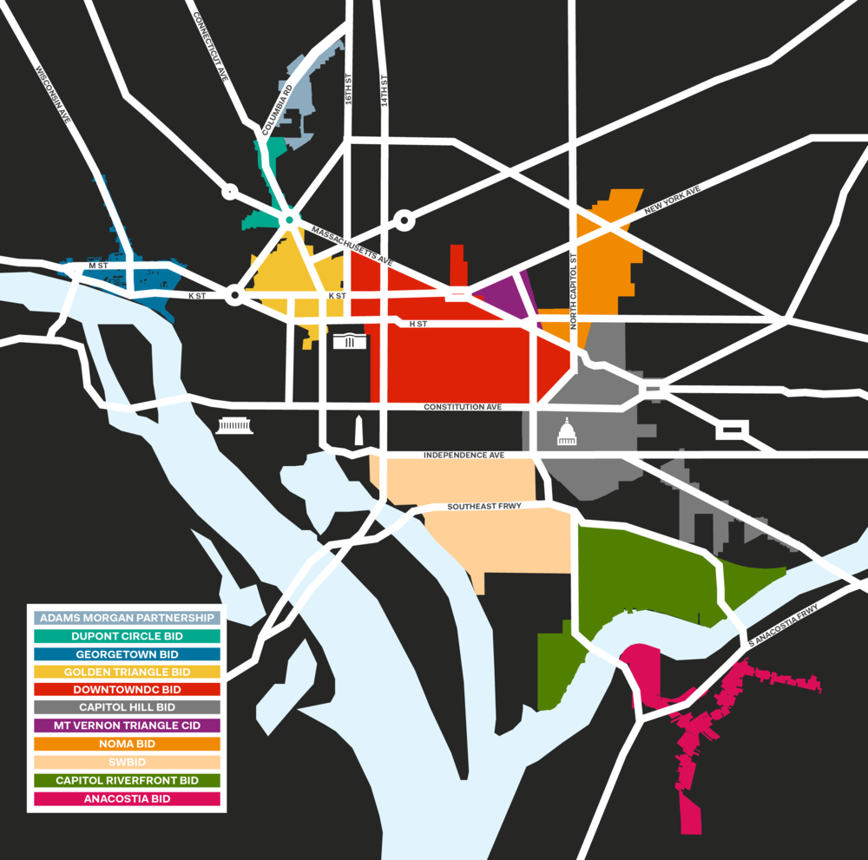
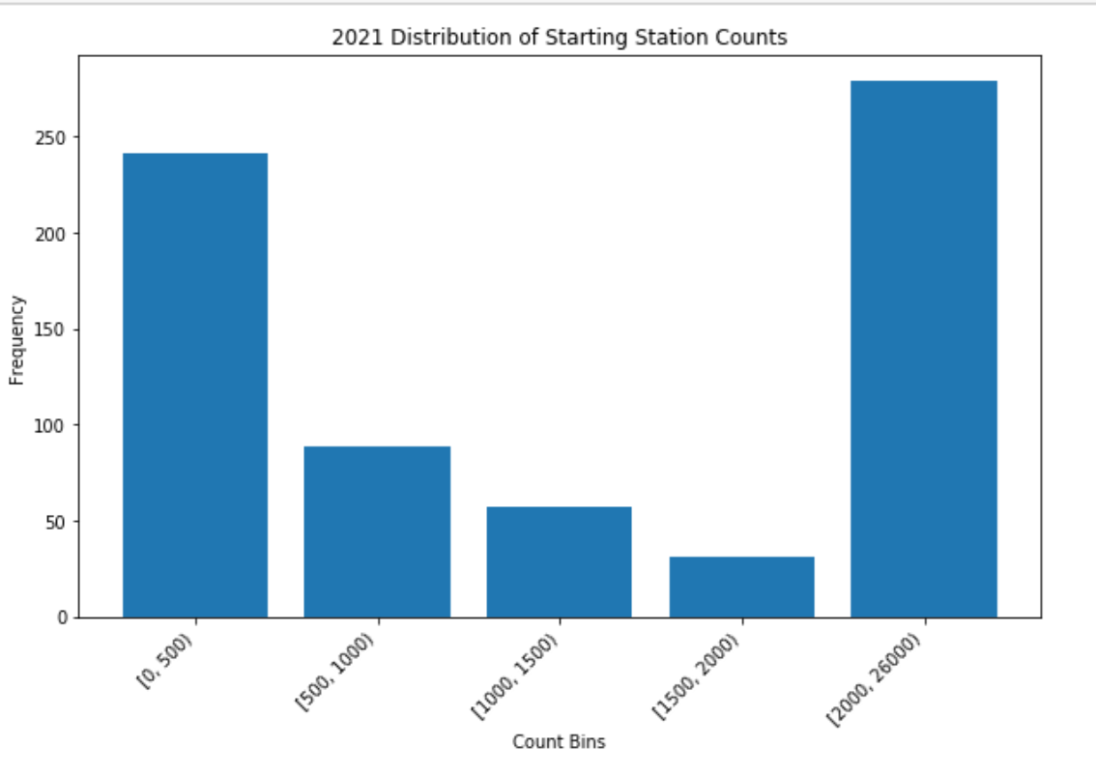
2021 Starting Stations
Weekdays from 6am to 6pm

Slide 13
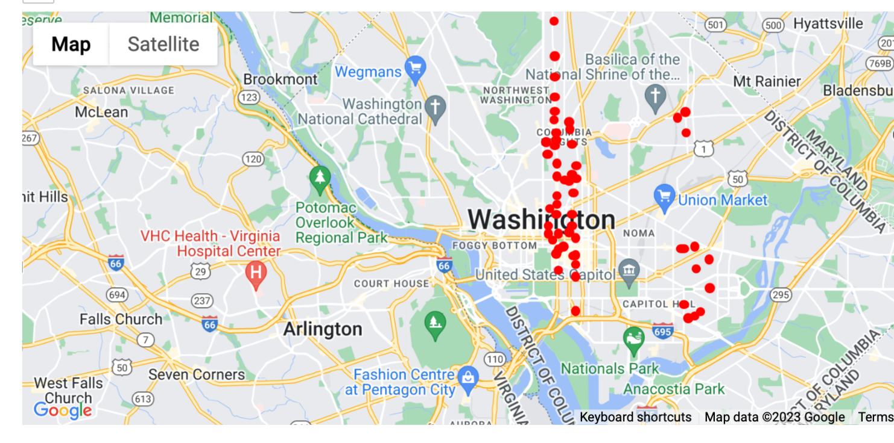
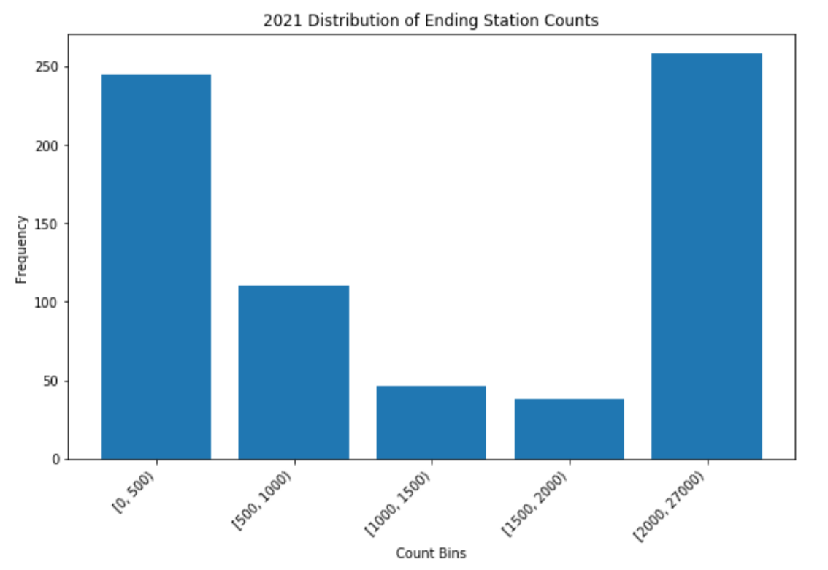
2021 Ending Stations
Weekdays from 6am to 6pm

Slide 14
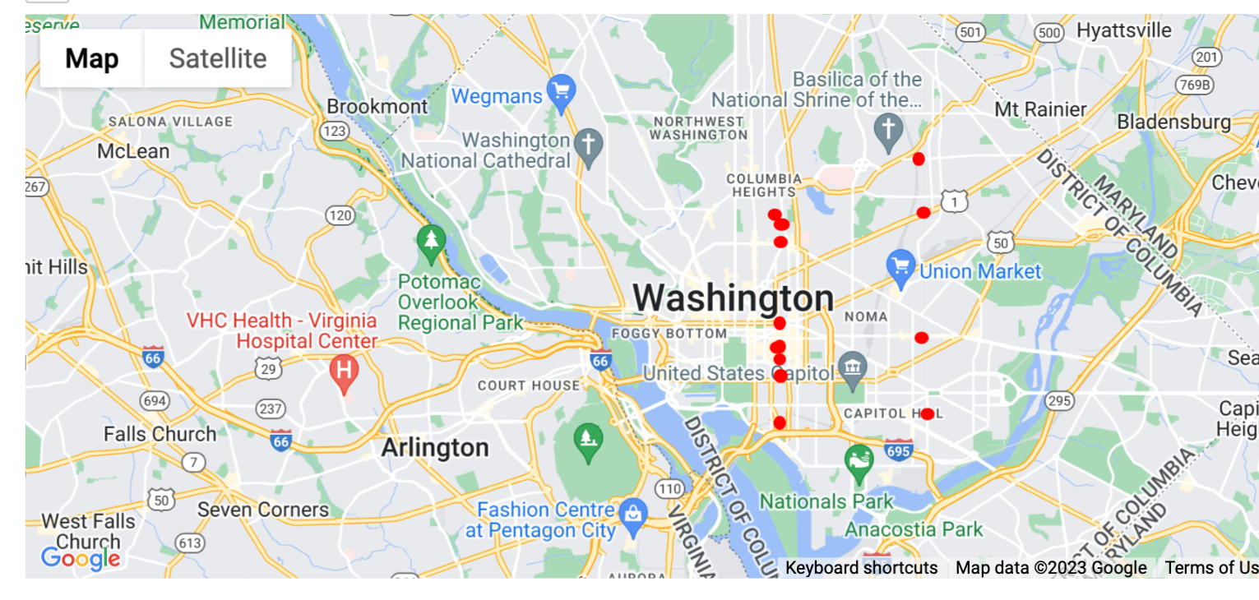
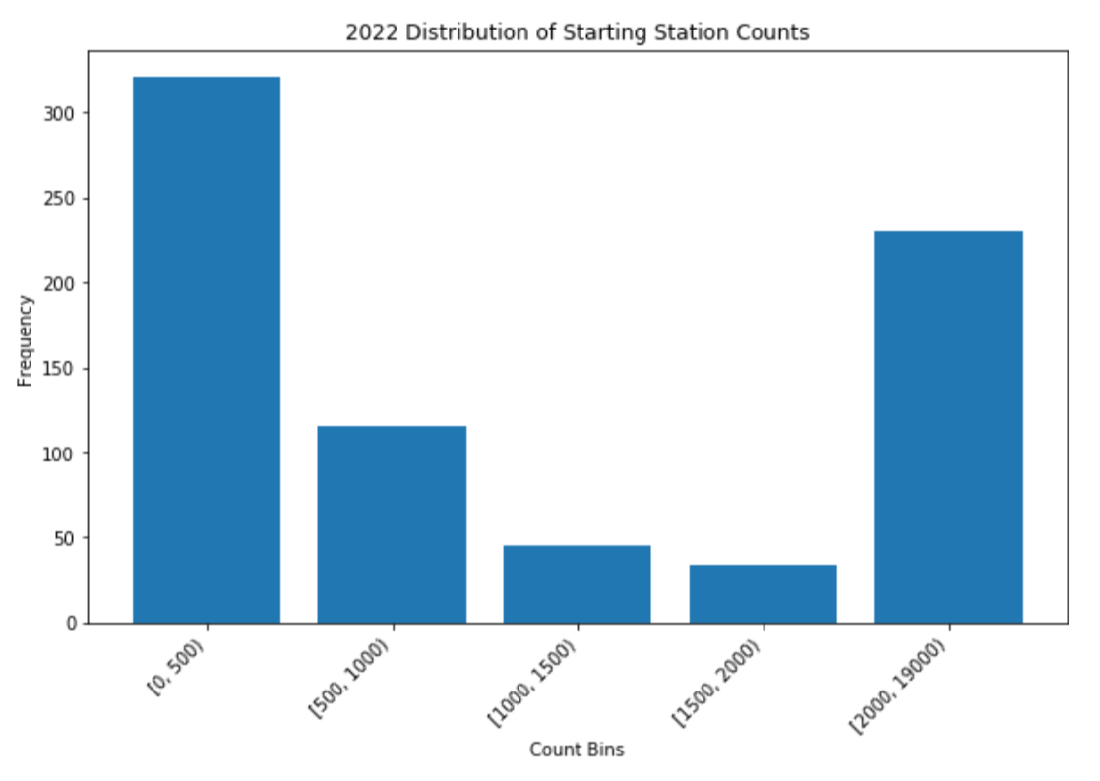
2022 Starting Stations
Weekdays from 6am to 6pm

Slide 15
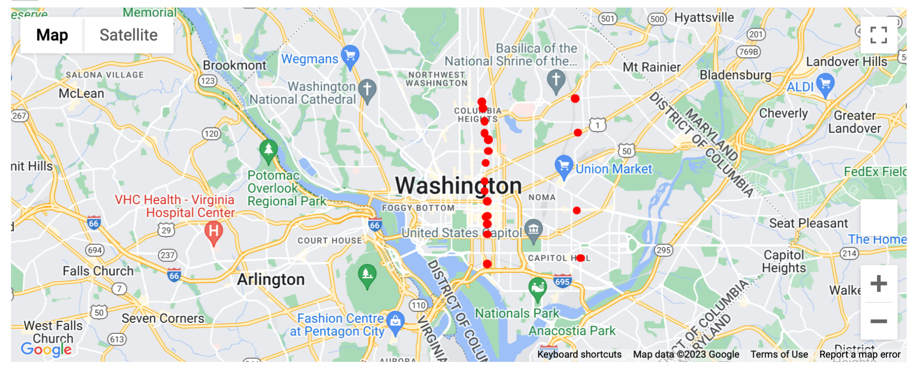
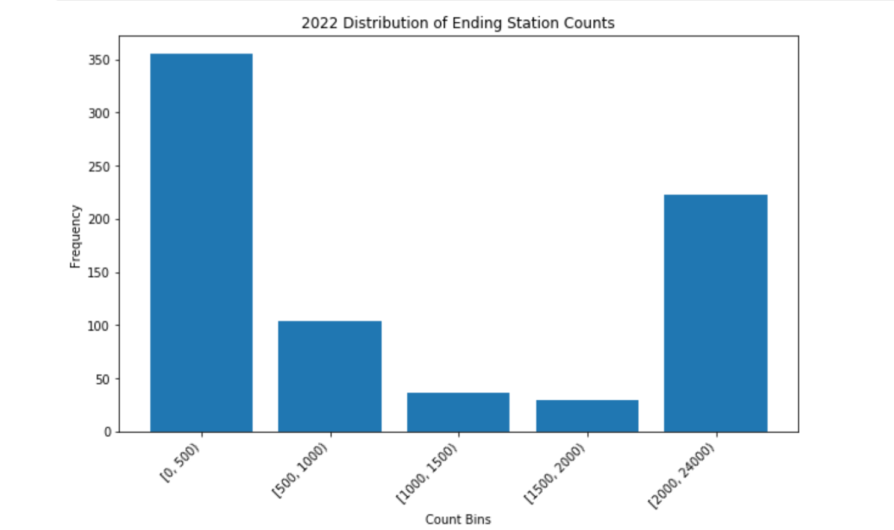
2022 Ending Stations
Weekdays from 6am to 6pm

Slide 16


